Slide 1
Critical educational scenario
“I also have rights"
Dr.Olga Panou

Slide 2
Identity of the Scenario
Title: I also have rights
Creator: Olga Panou
Subject: Social and Political Education of the 5th grade of Primary School
Teaching Objectives:
  Investigate and record the violation of the rights of the child.
  Formulation of messages / proposals for the protection of the rights of the child.
  Presentation and promotion of the rights of the child.
Keywords that characterize the theme of the scenario: Children’s rights
Infrastructure needed: Computer lab with 6 computers, video projector or alternatively six laptops or tablets per 4 students (20 students in total) (and one for the teacher). Internet connection.
Typical time of interaction with the educational scenario in teaching hours for work within the school: 3 hours
Type of interaction: Active learning and critical thinking
Interactivity and critical thinking level: High
Age group: 9-12
Educational level: Primary school

Slide 3
Educational issue
The violation of children's rights
The Convention on the Rights of the Child
The role of education and ICT in relation to the rights of the child

Slide 4
The pedagogical frame of the scenario
Constructivist Approaches
Recognize students' pre-existing knowledge
Emphasize building new knowledge upon what students already know
Encourage active student participation in the learning process
Socio-Cultural Approaches
View learning as a socially embedded activity
Stress the importance of interaction with others in learning
Acknowledge the influence of social, historical, and cultural contexts on knowledge construction

Slide 5
Inclusion of the scenario in the Curriculum
Social and Political Education of the 5th Elementary School:
  Chapter 1 "We know our rights, we undertake our obligations"
  Chapter 2 "We defend our rights"
  Chapter 3 "The Greek State protects our rights"
Information and Communication Technologies (ICT) in all activities
Promotes teamwork

Slide 6
Prerequisite knowledge in ICT for the digital teaching scenario
PC Operation | Skills | Internet and basic skills
Create folders and manage them. Create, save and print application files. | Text format. Cut / copy / paste functions. Import images and shapes, WordArt. | Use a browser (eg Internet explorer, Mozilla Firefox). Search engines (eg Google). Upload and save files from the internet. Web page printing. Email. Web 2.0: YouTube Posting and editing material in the padlet application (https://el.padlet.com/my/dashboard). Conceptual map of Text2Mindmap (http://www.text2mindmap.com/) «Tagxedo» application (http://www.tagxedo.com/app.html). «TOONDOO» application (http://www.toondoo.com/). «Sumo Paint» application (www.sumopaint.com). «ANIMOTO» application (https://animoto.com/).

Slide 7
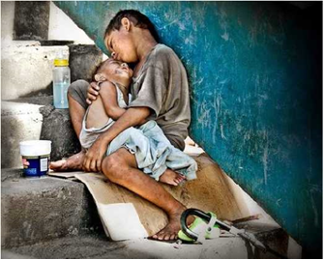
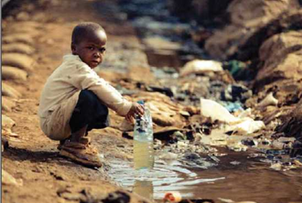
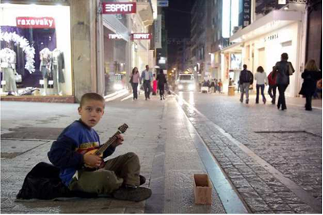
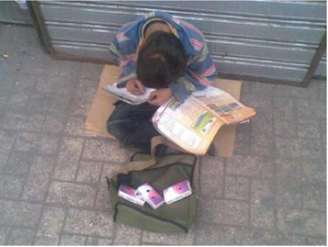
Phase 1
The goal of Phase 1 is for students to learn about the rights of the child by exploring them in various digital images
Duration:45 minutes
Place:Computer lab
Structural - Interactive elements: 8 Figures

Slide 8
Phase 2
The goal of Phase 2 is for students to decode various messages from Unicef videos on children's rights and to format their own messages
Duration:60 minutes
Place:Computer lab
Number of worksheets:1
Structural - Interactive data: Video on the rights of the child
https://socialpolicy.gr/2015/11/%CE%B2%CE%AF%CE%BD%CF%84%CE%B5%CE%BF-%CF%84%CE%B7%CF%82-unicef-%CE%B3%CE%B9%CE%B1-%CF%84%CE%B1-%CE%B4%CE%B9%CE%BA%CE%B1%CE%B9%CF%8E%CE%BC%CE%B1%CF%84%CE%B1-%CF%84%CF%89%CE%BD-%CF%80%CE%B1%CE%B9%CE%B4.html

Slide 9
Work sheet 1: Organizations for children’s rights
Agency/ organization | Website | I write a few words about the institution / organization
Unicef | https://www.unicef.gr/
The Ombudsman for Children | http://www.0-18.gr/
Child’s smile (Hamogelo tou paidiou) | http://www.hamogelo.gr/

Slide 10
Phase 3
The goal of Phase 3 is for students to work together to promote and publicize their child rights messages both in their school environment and in their local community
Duration: 45 minutes
Place: Computer lab
Structural - Interactive elements: Use of "padlet" application
  In the "padlet" application, students are encouraged by the teacher to post:
    1. The Convention on the Rights of the Child.
    2. Bodies dealing with the protection of the rights of the child
    3. The cloud dictionary created with the "padlet" application

Slide 11
Evaluation
Content
Understanding of each child's right
Suggestions and ideas proposed for the notification and protection of rights

Slide 12
Interactions
Quality of collaboration within each group
Cooperation and interaction between different groups

Slide 13
Results
Evidence of students' positive attitude towards children's rights
Engagement and reflection on the importance of rights in
real-life contexts

Slide 14
REFERENCES
Jones, A., Scanlon, E., Tosunoglu, C., Butcher, P., Murphy, P. and Greenberg, J. (1996).
Evaluating CAL at the Open University: 15 Years on. Computers and Education, 26(13), pp. 5-
15.
Jones, A., Scanlon, E., Tosunoglu, C., Morris, E., Ross, S., Butcher, P. and Greenberg, J. (1999).
Contexts for evaluating educational software. Interacting with Computers, 11, pp. 499-516.
McCroskey, C. J., Richmond, P.V. and Bennett, E.V. (2006). The relationships of student end-
of class motivation with teacher communication behaviors and instructional outcomes.
Communication Education, 55(4), pp. 403-414.
McLeod, J. and Vasinda, S. (2008). Critical Literacy and Web 2.0: Exercising and Negotiating
Power. Computers in the Schools, 25(3), pp. 259-274.
Scanlon, E., Tosunoglu, C., Jones, A.; Butcher, P., Ross, S. Greenberg, J. Taylor, J. and Murphy,
P. (1998). Learning with Computers: Experiences of Evaluation. Computers and education,
30(1/2), pp. 9-14.
Verhellen, Ε. (1996). Monitoring Children&#39;s Rights: The Hague. Kluwer Law International.
UNICEF (2014). Exhibition. The situation of children in Greece. The effects of the financial
crisis on children. Athens: UNICEF. (in Greek).

Slide 15
“Education is not the filling of a pail, but the lighting of a fire.”
W.B. Yeat

Slide 16
Thank you for your attention

